Slide 1

Computer ARITHMETIC
Lecture 2

Slide 2
Recap:
Binary numbers are a number system with base 2
Information represented inside a computer takes binary values.
Previous lecture dealt with the conversations between different number systems.
This lecture deal with basic mathematical operations (such as addition, subtraction and multiplication) for binary numbers

Slide 3
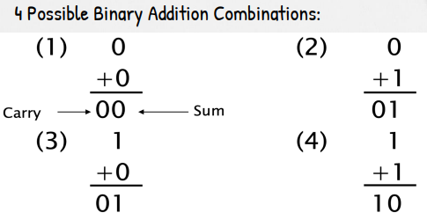
Binary Addition
Addition in the decimal number system:
  Add values rightmost position (least significant).
  If this addition is equal or grater than 10, 1 is carried to the 2nd position and added.
  This process is carried for all the positions.
Binary addition follows the same set of rules:
If the addition is equal or greater than 2 (102), 1 is carried to the 2nd next position.

Slide 4
Your Turn!
Perform the following binary additions
  a) 11012 + 10102
  b) 101112 + 011012
  c) 11102 + 1111 + 10112
  You may compare the answer by converting them to decimal number!

Slide 5
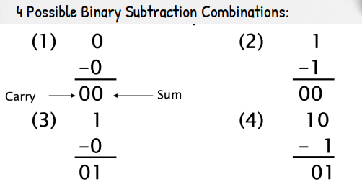
Binary Subtraction
Similar to subtraction in the decimal number system.
Inverse of addition.
If the value cannot be subtracted, borrow from the next position.

Slide 6
Your Turn!
Perform the following binary subtractions
  a) 101102 - 100102
  b) 10110112 - 100102
  c) 1011012 - 1001112
  You may compare the answer by converting them to decimal number!

Slide 7
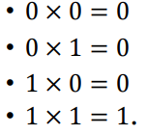
Binary Multiplication
Similar to multiplication and division in the decimal number system.

Slide 8
Your Turn!
Perform the following binary multiplication.
  a) 11002 x 10102
  b) 11112 x 1012
  c) 00112 x 112
  You may compare the answer by converting them to decimal number!

Slide 9
Self Study
Binary Division

Slide 10

Complimentary Arithmetic
Complements are used in digital computers for simplifying,
• the subtraction operation
• to represent negative numbers
There are 2 types of compliments for each base in any number system.
  𝑟’𝑠 compliment
  (𝑟 − 1)’𝑠 compliment
  Example: For binary numbers, 2’s complement and 1’s complement.

Slide 11

(r-1)’s Complement
N – Given Number
r – base
n – No of digits in given number

Slide 12
Get the 1’s complement of the following binary numbers
1100011
0001111
1010100
1111011

Slide 13

r’s Complement

Slide 14

Get the 2’s complement of the following binary numbers
1100011
0001111
1010100
1111011

Slide 15

End of Lecture

